Slide 1
Poultry House requirement and their effect on poultry health

Slide 2
:
1. Ventilators:
Most commercial poultry men use ventilating fans to insure adequate air circulation, and to control the rate of the air change. The number of ventilating fans depends on
a. Efficacy of fans
b. numbers of birds which were rearing in the field

Slide 3
.
The efficacy of fan measured by number of cubic meters or cubic feet of air pulled in minute or hour.
-Air quantity which pulled to change air farm (house) depend on:
1. Numbers of birds.
2-wieght of bird
3. Temperature.
-Each Kg/B.W of bird needed 3.5m³/hr.

Slide 4
Ex: chickens farm have10000 birds fan efficacy 10000 m³/hr, and average weight of bird in selling 1.8Kg
No. of bird multiplying of average weight
=weight of all birds
10000 × 1.8 =18000Kg
18000× 3.5= 63000 m³ /sec air quantity
Air quantity =63000 =6.3 No. of fans
Fan efficacy 10000

Slide 5
2. Temperature:
This factor has greatest impact on the poultry living conditions and on their performance.
In bird; the body temperature regulation mechanisms of chicks are not very effective during the few day of life.
Therefore; the building should be warmed up 45 hours before the arrived of new chicks. At start up until adult feathering ,avoid temperature variation

Slide 6
Temperature
-In first week 33-35c⁰,
second week 31-33 c⁰,
third weeks 28-29 c⁰,
Fourth weeks 27-25 c⁰
sixth-eight 21 c⁰.
Thermometers must be patting in different location of poultry farm.

Slide 7
Litter:
An important point in maintaining comfortable condition in the poultry house is having the right kind of litter. Many different materials are used for this purpose depending largely on what is locally available . Among the materials in common use are wood shavings.
The litter should be lowest cost , light weight and ability to absorb the humidity .
Litter thickness in summer 4cm , in winter 6-10 cm.

Slide 8
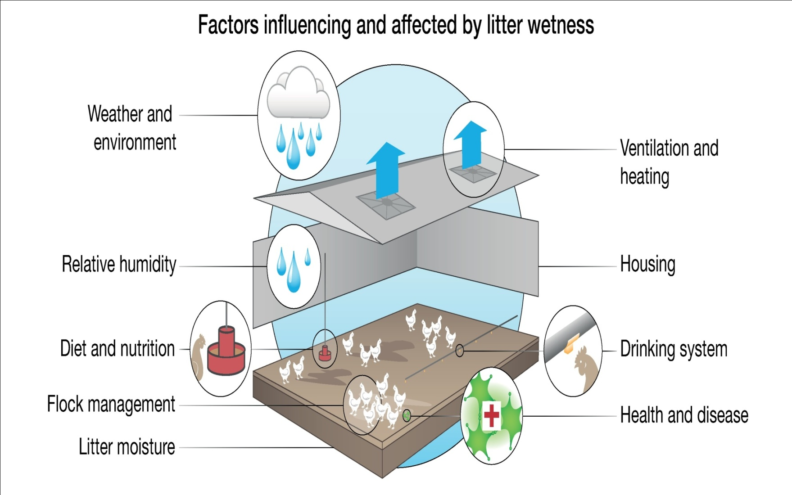

Slide 9
.
Humidity
Humidity rate (20-25%) and if increased this mean bad ventilation
Ammonia
Ammonia has an irritating and toxic effect on respiratory system . The consequences of high level of ammonia are respiratory diseases ,impaired immune system , drop in feed and growth retardation .
For factors are involved in the production of ammonia , humidity , heat and fermentation .

Slide 10
High levels of ammonia in a poultry house have negative impact on poultry growth particularly at an early age.
Feed conversion and weight gains in poultry are also affected by high levels of ammonia.

Slide 11
To reduce the production of ammonia;
1-provide good ventilation , temperature and humidity.
2- Ensure the quality of the litter is good .
3- Maintain the litter , by added superphosphate 300kg / 1000m.

Slide 12
:Light
In chickens there are three major functions of light: 1. to facilitate feeding 2. to stimulate internal cycles due to day-length changes, and 3. to initiate hormone release.
Light is of central importance in poultry production, as producers want to provide optimum conditions for the birds to reach their full genetic potential.

Slide 13
:In layers
Duration depends upon the age of the chicken and type of housing you use. Chicks can be exposed to 21-23 hrs of continuous light at one and two days of age and then reduced to 15 or 16 hrs of light until the birds are three weeks of age. (Chicks have a very low fear response during their first three days of life and can be exposed to many environmental stimuli, such as new housing, light and dark, etc. without much adverse effect.)

Slide 14
At three weeks of age, reduce the hours of light to 10-12 hours or by natural day length. In summer for open housing use decreasing hours of light up to six weeks of age and then hold constant to avoid delays in maturity. When target body weights are achieved start your stimulatory lighting program. Jump to 13 hours and then add 15-30 min per week until 16 hrs of light is reached. Light stimulation should continue until peak production is achieved.

Slide 15
In broilers
Duration depends upon the age of the chicken and type of housing you use. Broiler chicks can be exposed to 20-23 hrs of continuous light at one and two days of age and then reduced to 18 - 20 hrs of light . Recent research has shown that darkness is just as important to the health and growth of birds as is light. During the dark phase, melatonin, a hormone released by the pineal gland, is released. Melatonin has been associated with immune function and disease resistance. Birds provided with sufficient dark periods have fewer health related problems, including sudden death, spiking mortality and leg problems.

Slide 16
Stock density:
In adult broilers, number of birds 10/m² and in winter12/m².
In chicks ,in summer: first week 30/m².Second week 20/m²,third –selling 10/m²
in winter 1st week 40 ,2nd wk 30, 3rd wk20, 4th –selling 12/m² .

